Slide 1
EVAN An application for Emergency Vehicle Assistance Network

Slide 2
Presentation Outline
1
2
3
4
Introduction
Motivation & Problem Statement
Project objectives
EVAN Services
5
6
7
8
Methodology
Results
Conclusions
Future Work

Slide 3
INTRODUCTION
Imagine you're driving down a peaceful countryside road, enjoying the scenic beauty, when suddenly, your car sputters and comes to a halt. Panic sets in as you realize you're miles away from any help
Our road service app is designed to revolutionize the way you navigate unforeseen circumstances on the road. It's time to take control of your journey and eliminate the stress and uncertainty associated with car troubles.

Slide 4
EVAN is not just another roadside assistance app. It's your trusted companion, ready to assist you whenever you're faced with an unexpected breakdown or emergency.
Whether it's a flat tire, dead battery, or even running out of fuel, EVAN has got you covered. Our service providers are equipped to handle any roadside mishap, bringing you peace of mind even in the most challenging situations.

Slide 5

Motivation & Problem Statement
Roadside breakdowns and emergencies can happen unexpectedly, leaving individuals stranded and in need of immediate assistance.
Limited accessibility to reliable roadside assistance services in certain areas, particularly remote or less populated regions, leaving individuals stranded without timely support.
People desire a trustworthy and efficient companion that can reliably assist them during roadside mishaps, providing peace of mind and ensuring their safety.

Slide 6
Project objectives
DEVELOP A USER-FRIENDLY AND RELIABLE MOBILE APPLICATION.
BUILD A NETWORK OF RELIABLE SERVICE PROVIDERS.
INTEGRATE GPS TECHNOLOGY TO LOCATE USERS.
PROVIDE REAL-TIME UPDATES ON SERVICE PROVIDER ETA.
ENSURE TRANSPARENCY IN PRICING AND SERVICES.
IMPLEMENT EFFECTIVE CUSTOMER SUPPORT.
.

Slide 7
Evan SERVICES
Battery issues
Flat Tire
Towing
Car locked
Car won’t start
Gas delivery

Slide 8

Methodologies
Use Case diagram
System
Create account
Login
Login
Show user location
Logout
Show user information
Select a service
Call the user
user
Call the provider
admin
Provide the users with the service they need
Submit the order
View profile

Slide 9
Data flow diagram
Customer
Check
Database server
Car services
No
registration
Login page
Check username and password
Provide a set of
services
yes
Enroll in the system
Store customer
data
Import services
Enrolments data
Feedback,bill
Order again
Prepare data
Provide cost, location
And witting time
Export location
And co
Apply algorithms
Find location Calculate time And cost

Slide 10
Flow chart
Start the app
Splash screen
Contact us
Login Check
Login Activity
No
Already Logged In?
Yes
Home
View Profile
Yes
Logout
end
Registration
No
Have Account?
Yes
Login
Select service
Set location
Submit order
Waiting provider
end

Slide 11
How our application works
Step 1
Step 2
Step 3
Step 4
Step 5
Login or registration
Select service
Receive location
configuration
Confirm your order
Wait and
pay

Slide 12
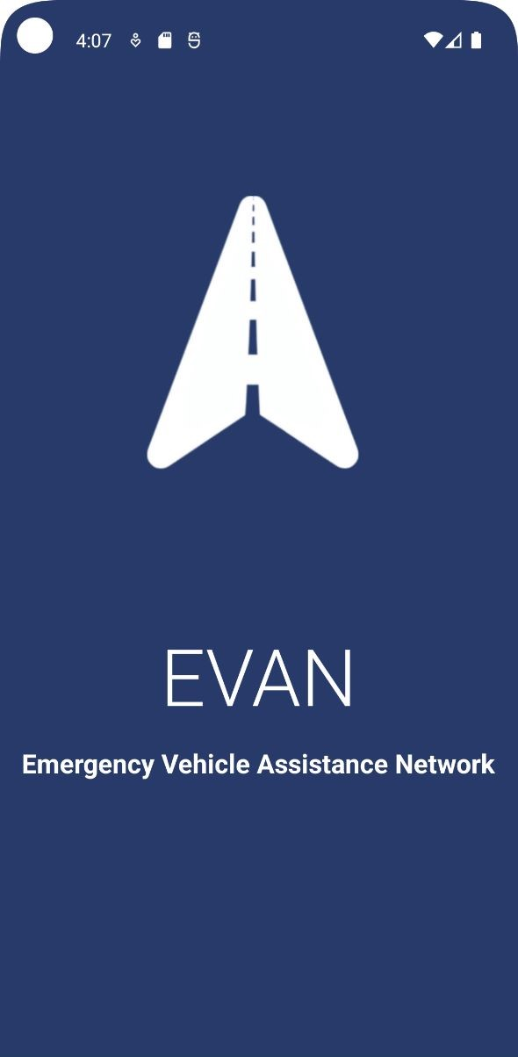
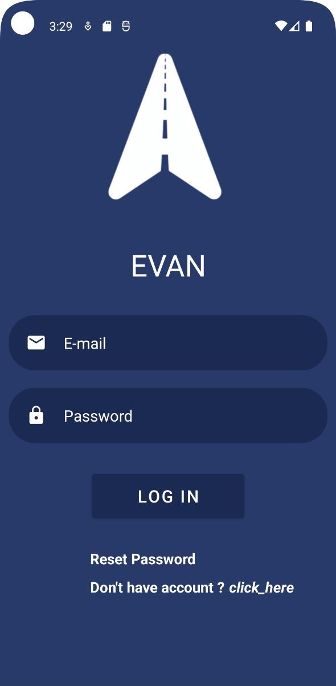
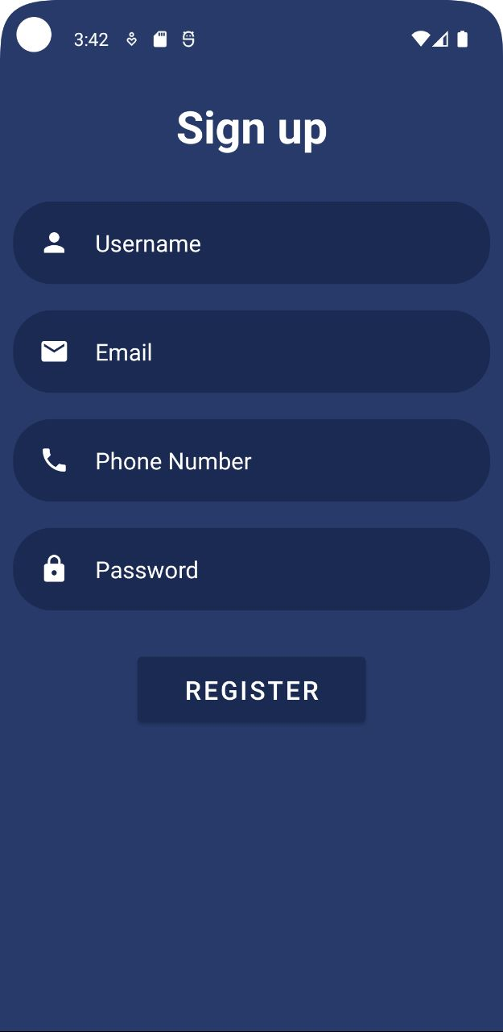
User Results
Login and
registration

Slide 13
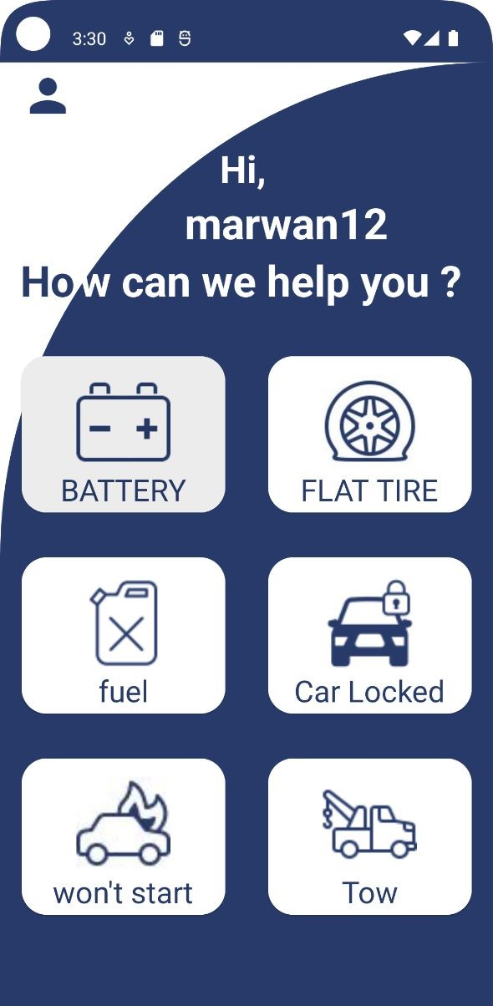
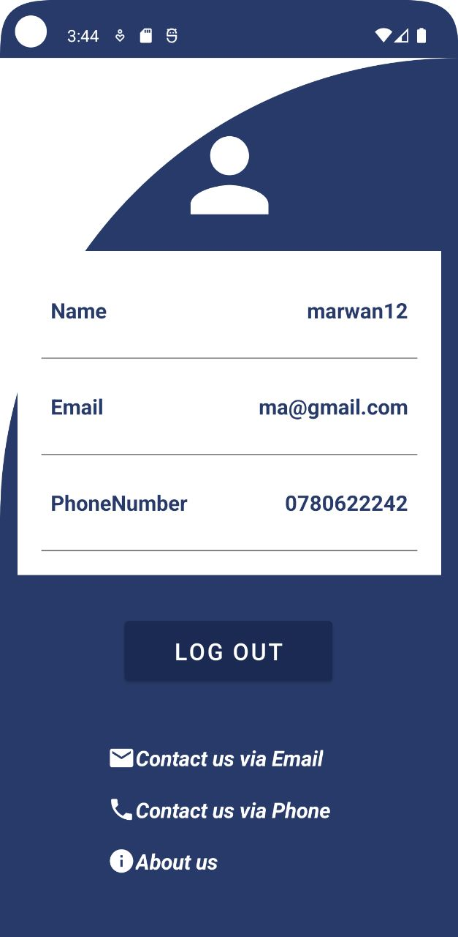
User Results
Profile and
Home

Slide 14
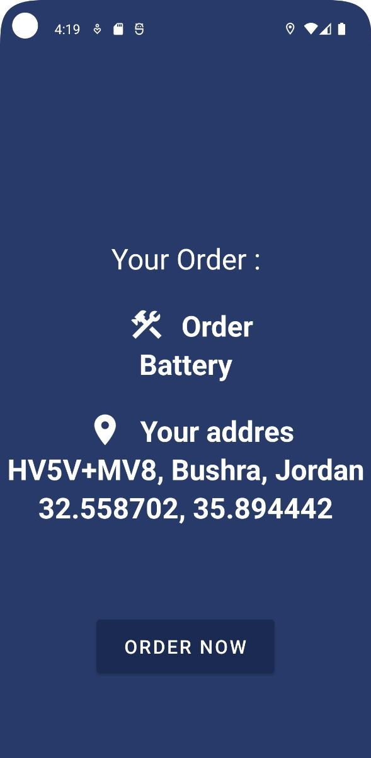
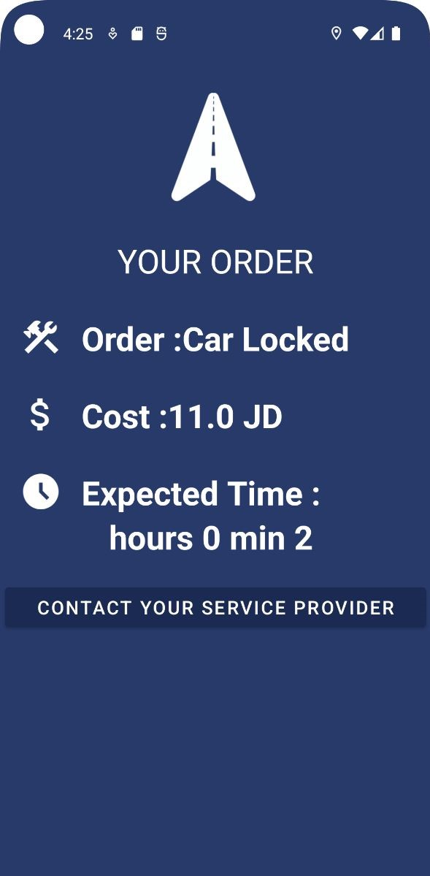
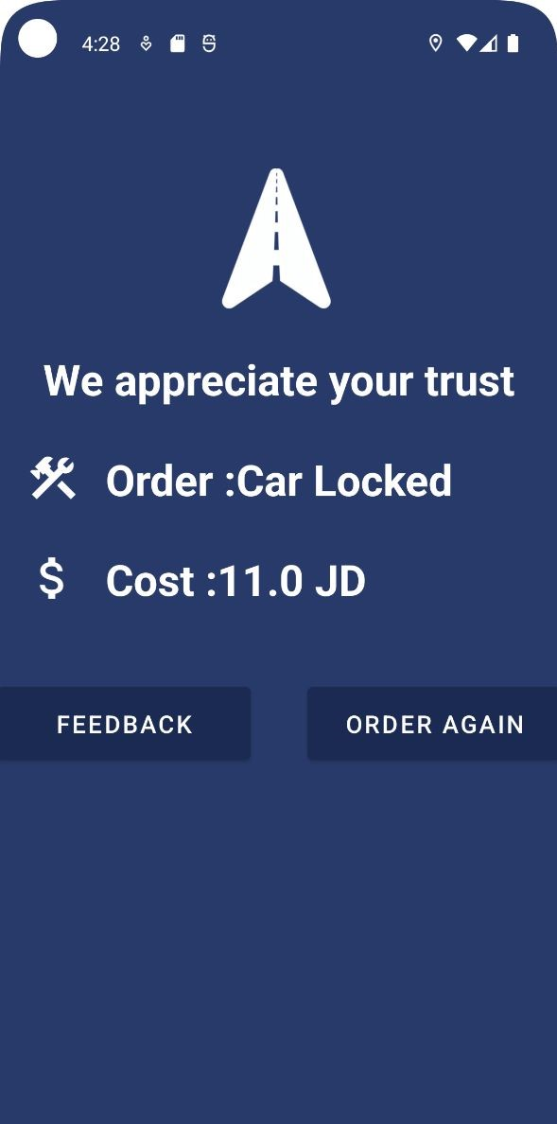
User Results
Submit order and waiting for
provider

Slide 15
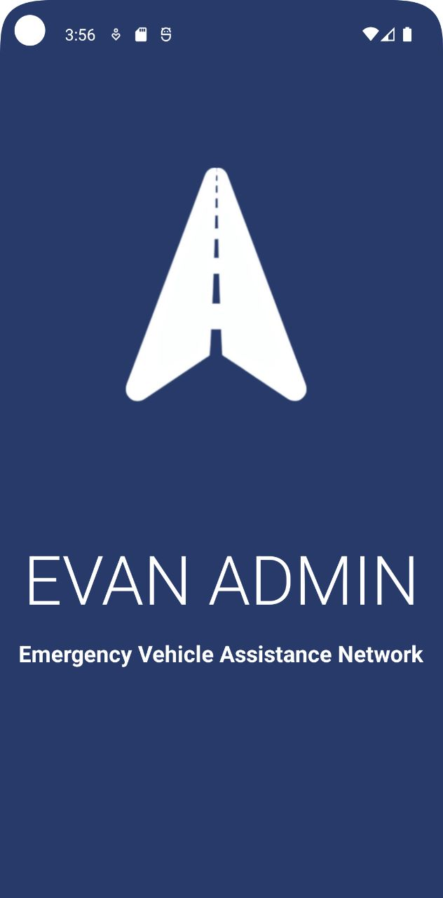
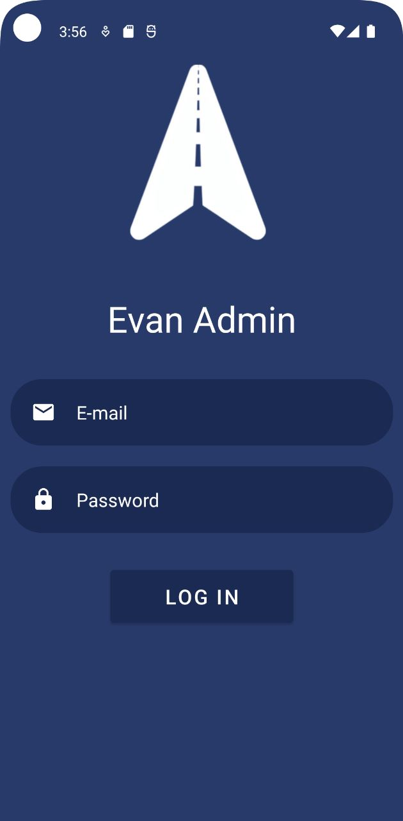
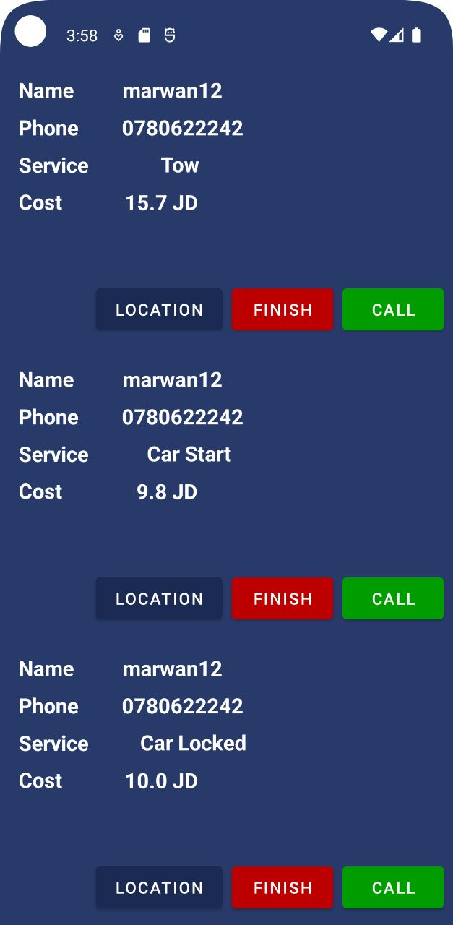
Admin Results
Login and order

Slide 16
CONCLUSION
EVAN is a road service app designed to provide assistance in case of unexpected car breakdowns or emergencies.
The App Aims To Revolutionize The Way People Navigate Unforeseen Circumstances On The Rode.
Evan serves as a trusted companion, ready to assist users even when they are miles away from help.
.

Slide 17
FUTURE PLAN
Make The Application Compatible With Ios.
Make our services available worldwide.
Make The Application Available In Multiple Language.
Create partnerships with other businesses to expand the quantity of services.

Slide 18
SUMMARY
Evan is the convenient and user-friendly solution for drivers in need. With 24/7 availability, GPS location, service customization, transparent updates, low cost payment, and a feedback system, it simplifies emergency help on the road.

Slide 19
Presented by
Radwan
Al Zoubi
Marwan
Al Harahsheh
Nasser
Abo Aisha
Malik Obeidat

Slide 20
THANK YOU

